Slide 1
CS- 584 MACHINE LEARNING FINAL PROJECT MUSIC RECOMMENDATION SYSTEM USING EMOTION RECOGNITION
TEAM MEMBERS:
DIKSHITHA VARMAN – A20521565
JAYASURYA RATHINAGIRI – A20513480
KIRAN GOPI – A20520561
INSTRUCTOR:
Dr.Yan Yan

Slide 2
AGENDA
INTRODUCTION
DATASET
IMPLEMENTATION DETAILS
MODULES
EMOTION DETECTION
SPOTIFY API
FLASK FRAMEWORK
VGG16 MODEL
IMAGE PROCESSING
RESULTS
FUTURE WORK

Slide 3
INTRODUCTION
Managing a large music collection can be challenging for listeners who have to manually create and organize playlists with hundreds of songs. This can be a time-consuming and tedious task that can also lead to wasted device memory if unused songs are not properly managed.
Selecting songs based on mood and preference can also be a hassle for users who have to do so manually each time they want to listen to music. This can be especially challenging when preferences and play-styles change over time, making it difficult to reorganize and play music.
To address these issues, a machine learning approach that utilizes facial scanning and feature tracking has been implemented to detect the user's mood and generate a personalized playlist based on it. This approach can help users save time and effort by automating the process of creating and selecting music playlists that match their mood and preferences.

Slide 4
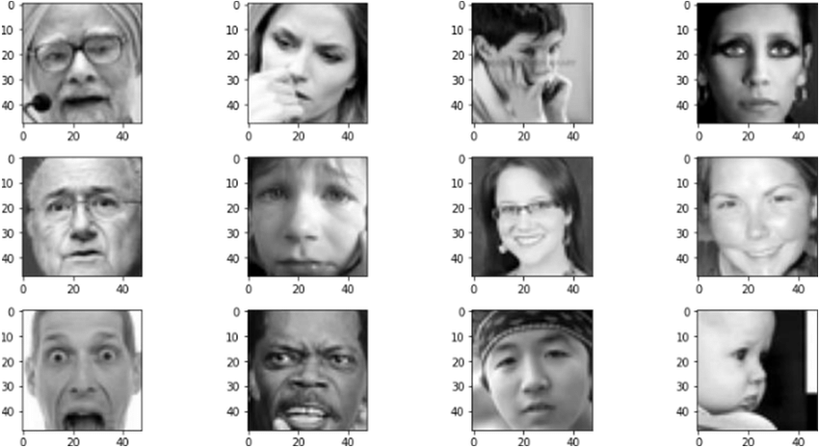
DATASET FER2013
The FER2013 dataset is a publicly available dataset consisting of 35,887 grayscale images of faces that are 48x48 pixels in size.
The images are labeled with one of seven different facial expressions: angry, disgust, fear, happy, sad, surprise, and neutral.
The dataset is split into three subsets: a training set, a validation set, and a test set, with the training set containing 28,709 images, the validation set containing 3,589 images, and the test set containing 3,589 images.

Slide 5
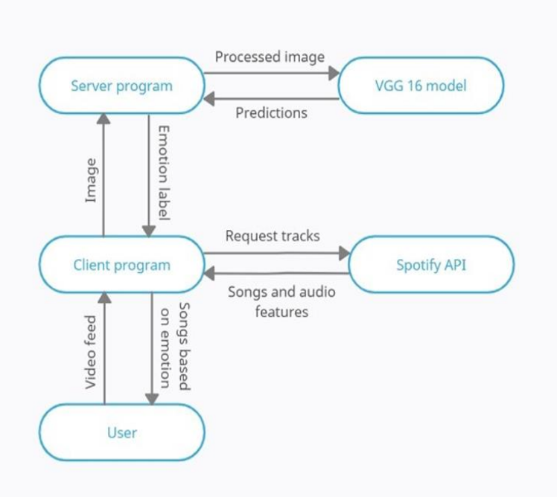
IMPLEMENTATION DETAILS

Slide 6
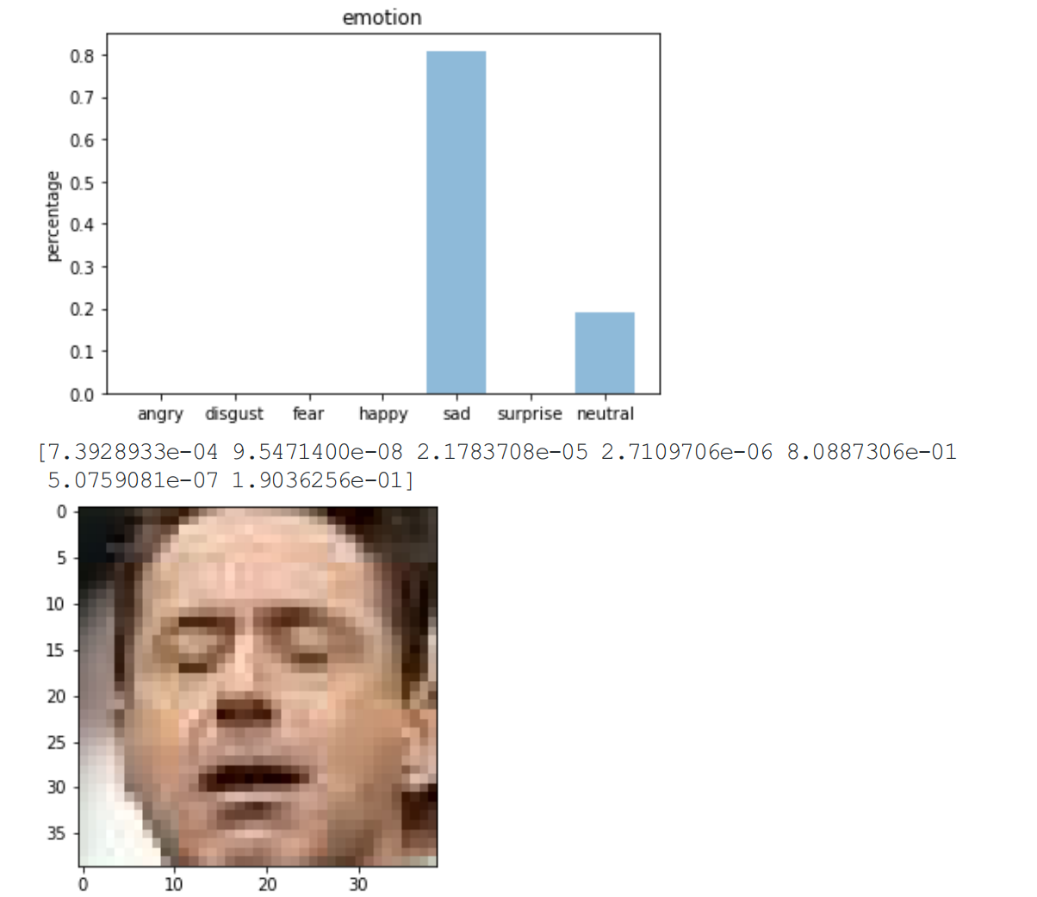
Modules
EMOTION DETECTION
The system has an "emotion function" that detects emotions using a pre-trained VGG16 model and a Haar Cascade classifier from OpenCV.
It takes an image as input, processes it, and applies the classifier. If a face is found, the model makes a prediction and returns an emotion label.

Slide 7
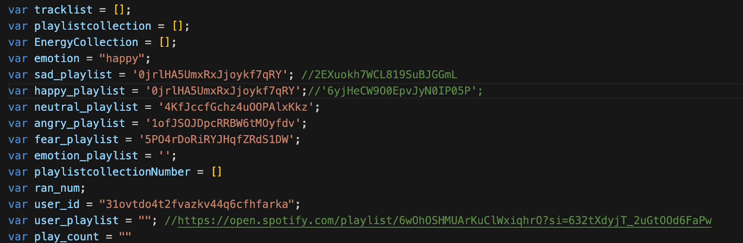
Modules
Spotify api
The system uses the Spotify API to access information about tracks, devices, and audio features.
It uses two functions, "requestAuthorization()" and "callAuthorizationApi()", to obtain an access token for authentication purposes.
The "callApi()" function is used to send requests to the Spotify accounts service for various types of information.

Slide 8

Modules
FLASK FRAMEWORK
The system's server is built on the Flask framework. It has two routes, "home" and "emotion".
The "home" route returns the application webpage, and the "emotion" route receives an image and returns an emotion label.
The "emotion” route uses the "emotion function" for emotion detection.

Slide 9
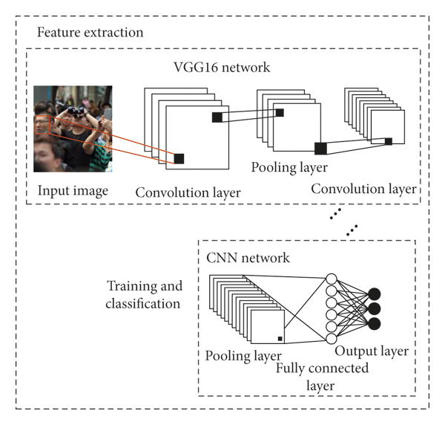
Modules
Vgg16 model
The VGG16 model used for emotion detection was trained for over 400 epochs with 478 images in each batch.
Various hyperparameters were tuned throughout the course of training.
The model achieved an accuracy of around 98% on the train set and around 70% on the test set.

Slide 10
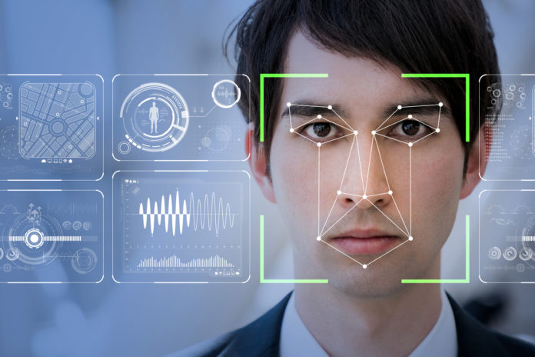
Modules
Image processing
The input image is pre-processed by the "emotion function" before applying the Haar Cascade classifier.
If no face is found, a "nil" label is returned. If a face is found, the "emotion function" sends the last face found to the VGG16 model for emotion detection. The predictions are analyzed, and an emotion label is returned.

Slide 11
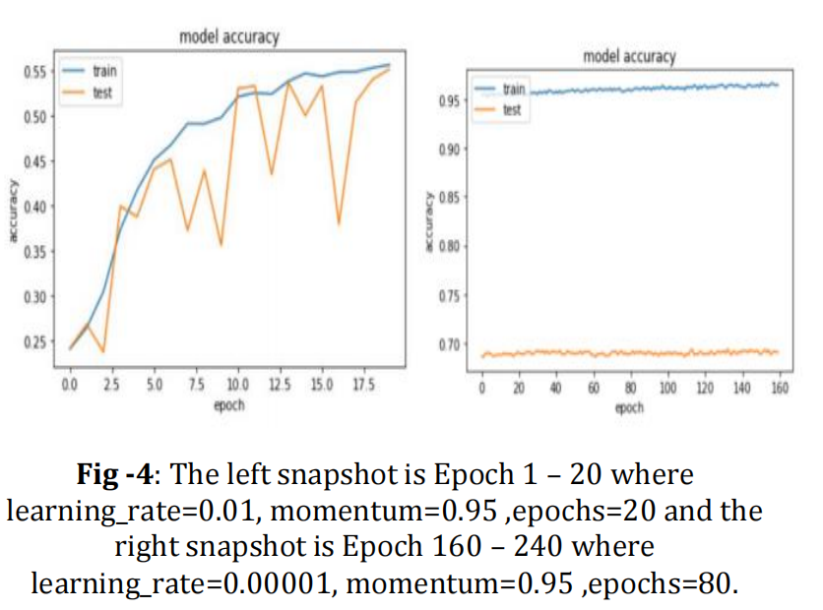
RESULTS

Slide 12
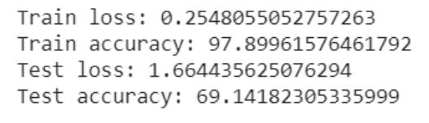
RESULTS

Slide 13
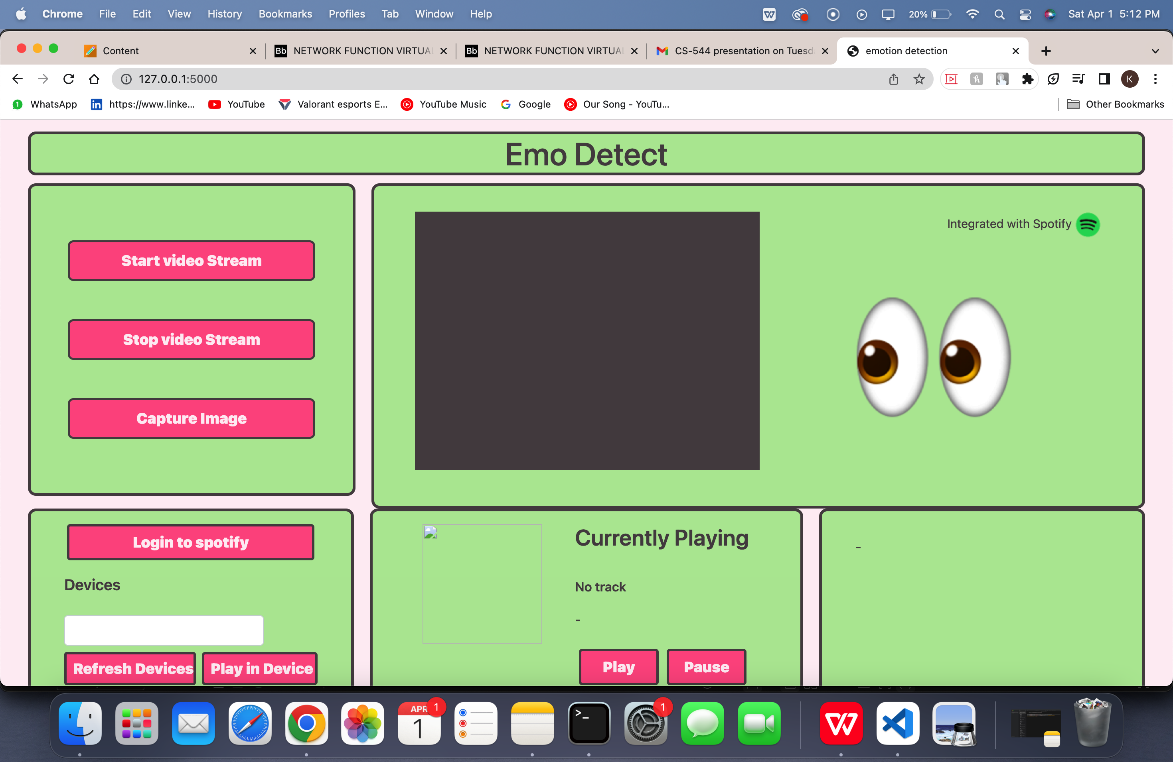
APPLICATION HOMEPAGE

Slide 14
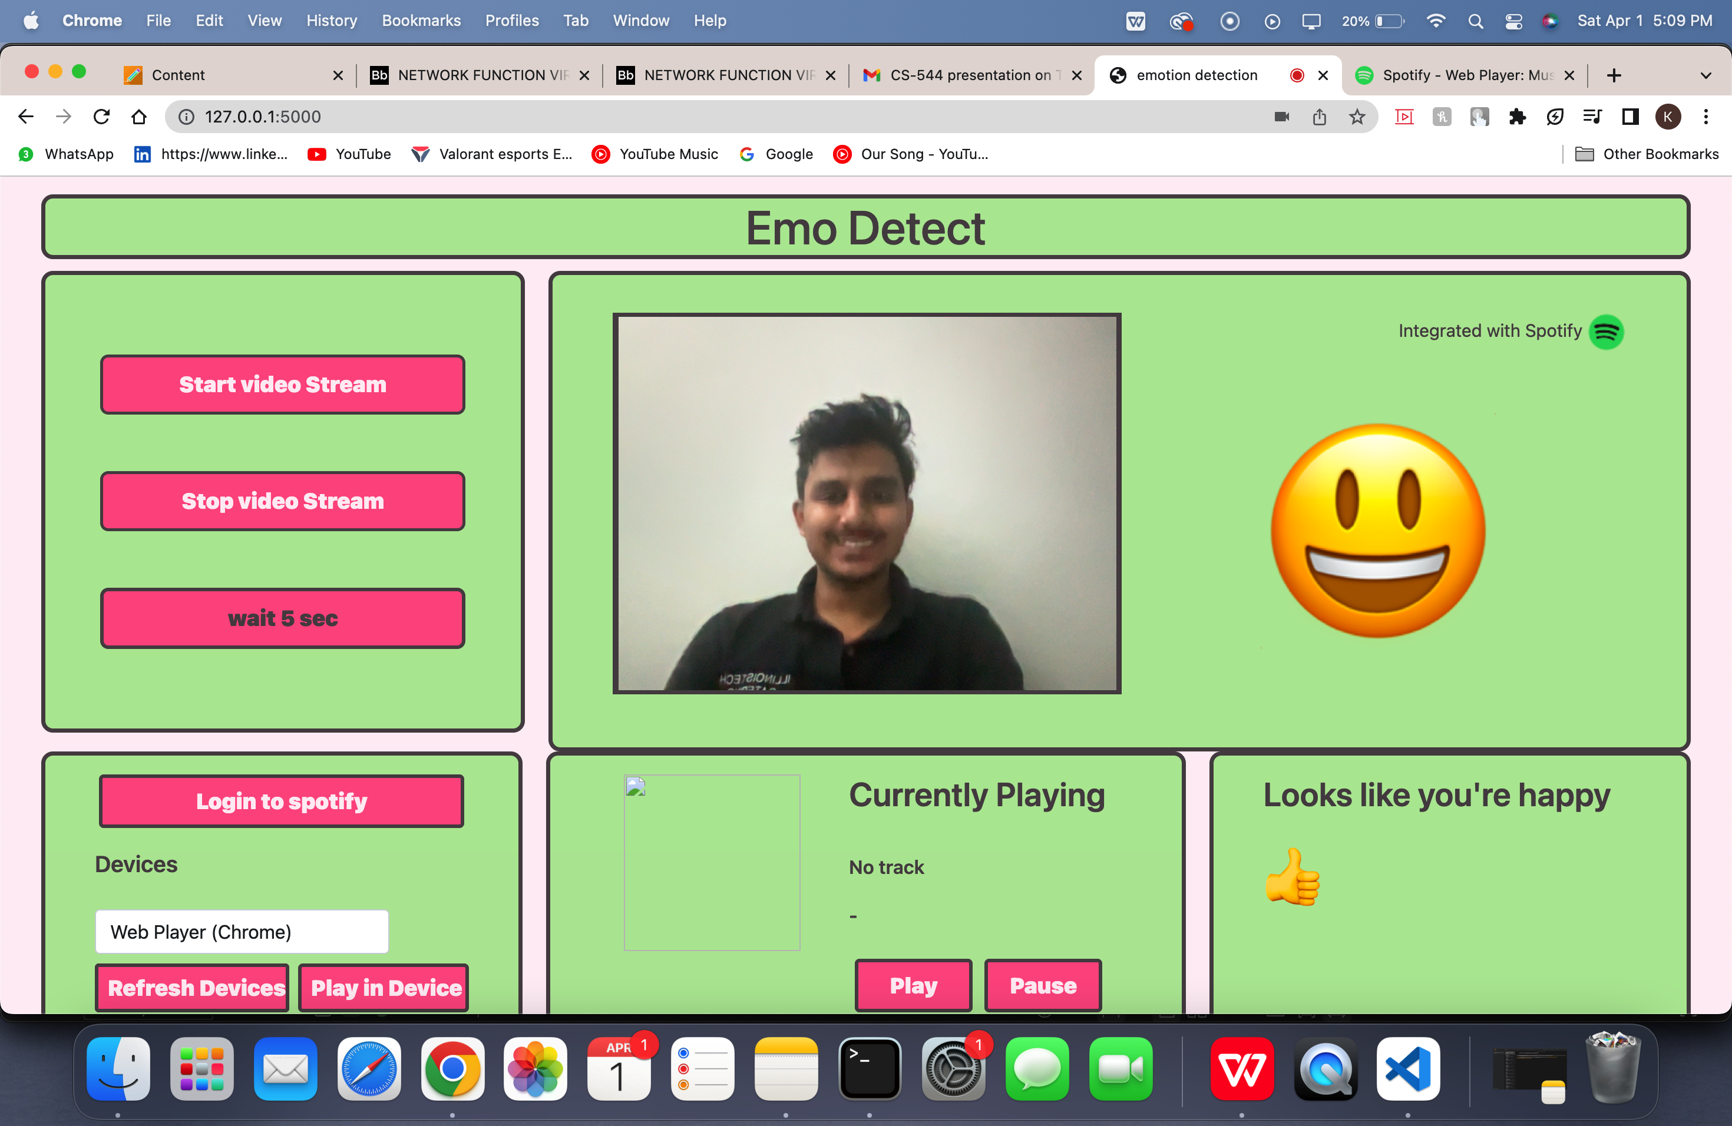
EMOTION DETECTION EMOTION DEDUCTED: HAPPY

Slide 15
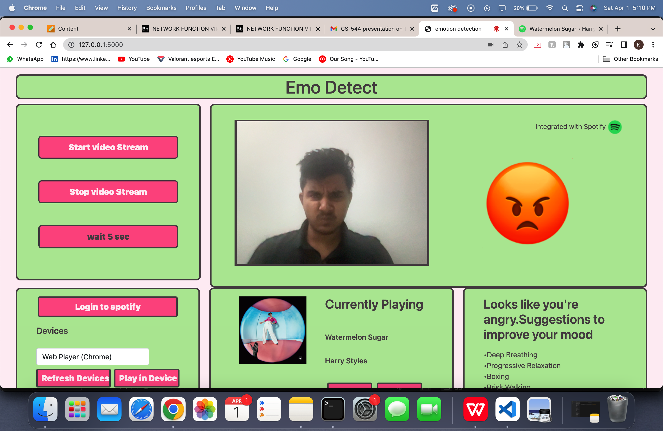
EMOTION DETECTION EMOTION DEDUCTED: ANGRY

Slide 16
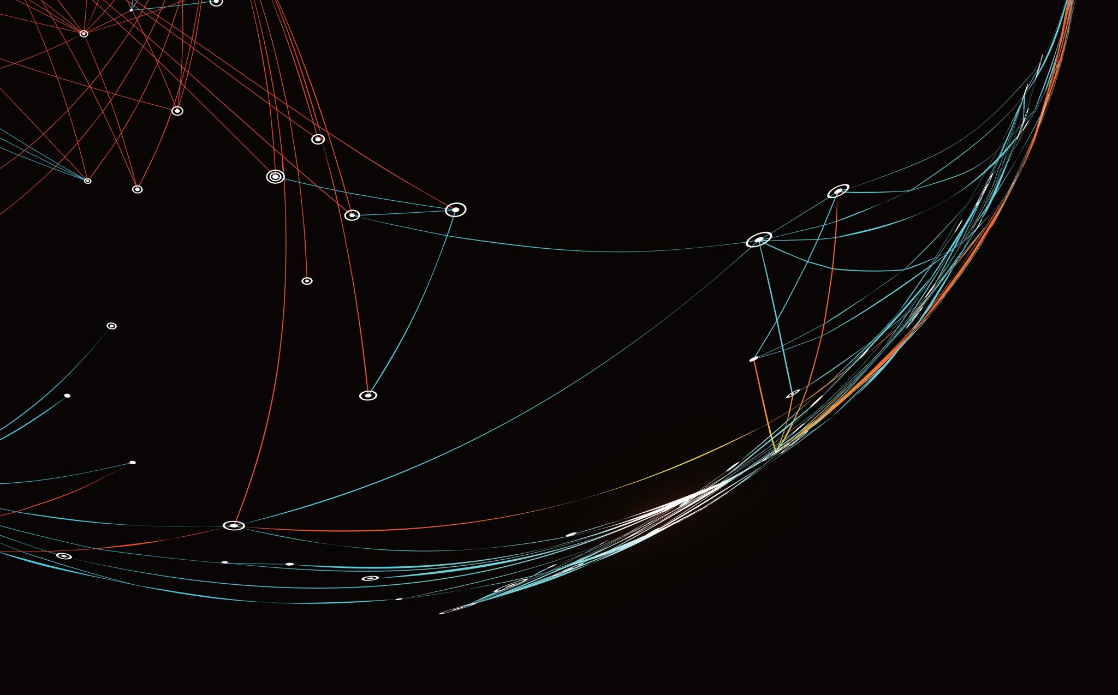
FUTURE WORK
Multiple face detection must be handled.
More songs need to be analyzed and added to different emotion playlist as we have kept 10 songs for each playlist
Currently our application plays music in the Spotify web player and we are working on to play the music in the primary application itself where we have provided with the “Play in Device” button in the UI.

Slide 17
THANK YOU

